Slide 1
COMPUTER REPAIR AND MAINTENANCE
Disk cloning using mini tool wizard partition

Slide 2
Introduction
When employing hardware or software to duplicate all of the data on a digital storage device, like a hard disk or solid-state drive, the process of disk cloning is essential. Disk cloning duplicates not just the data but also the filesystems, partitions, drive metadata, and slack space on the drive, in contrast to conventional file copying. Next, I performed the disk cloning on my end using the freeware Mini Tool Wizard Partition.
When employing hardware or software to duplicate all of the data on a digital storage device, like a hard disk or solid-state drive, the process of disk cloning is essential. Disk cloning duplicates not just the data but also the filesystems, partitions, drive metadata, and slack space on the drive, in contrast to conventional file copying. Next, I performed the disk cloning on my end using the freeware Mini Tool Wizard Partition.

Slide 3
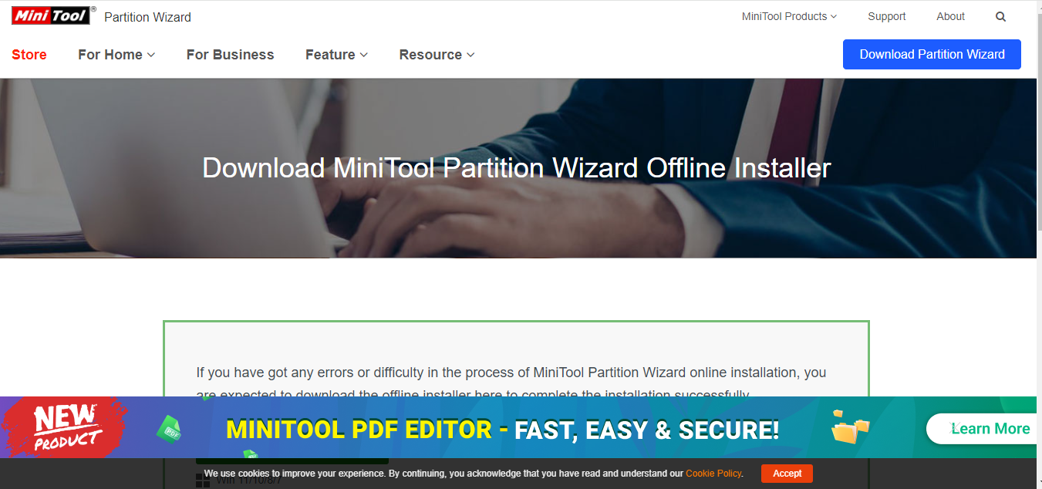
First of all I went to the browser then to google and I look for the mini tool wizard partition, then I went to downloaded.
This is the website I visited and downloaded the Mini tool wizard partition from, as you can see.

Slide 4
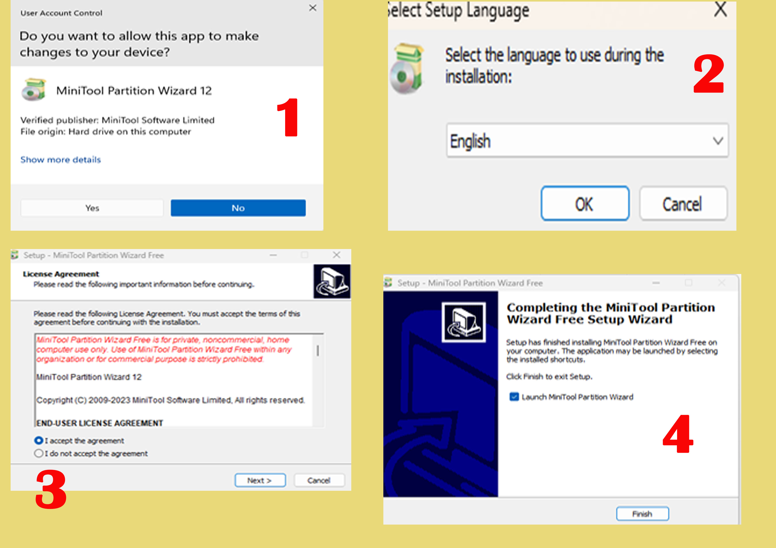
After downloaded Mini Tool wizard partition, I installed it on my computer I was following the instructions on the screen to install the software of Mini Tool Wizard partition as the pictures shows bellow :
Pictures of steps
Content
These photos demonstrate my steps during the installation, which was completed entirely. I then used Mini Tool Wizard Partition on my computer to begin the cloning procedure. Here, I connected the external hard drive to my computer and began the copying process.

Slide 5
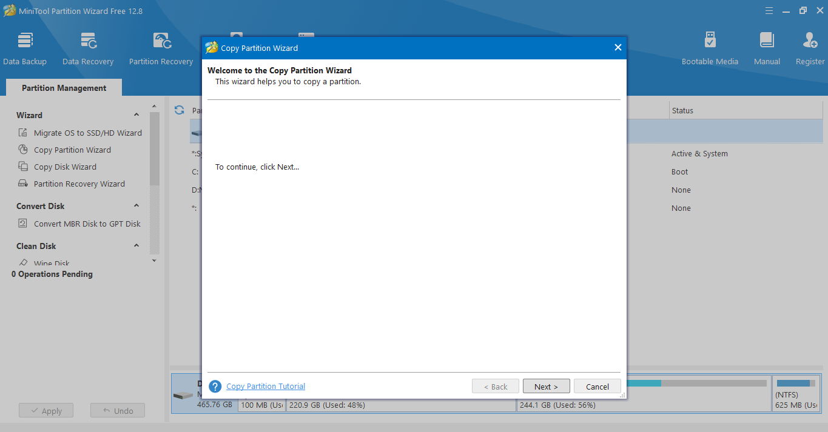
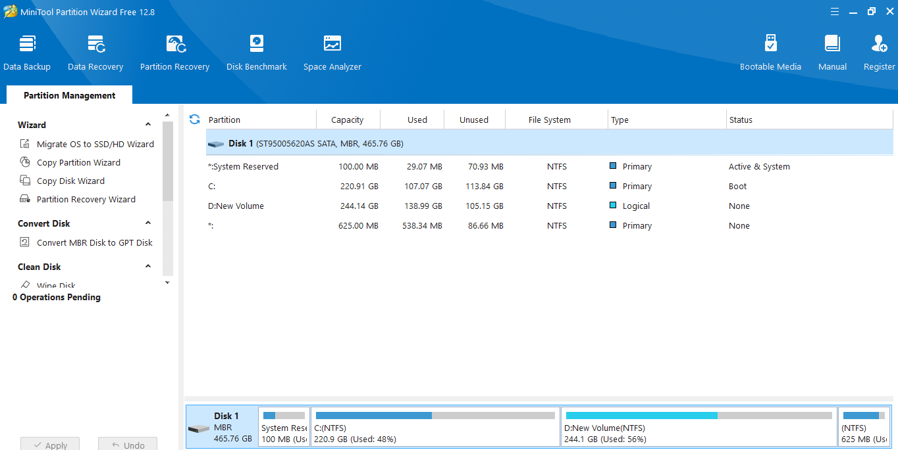
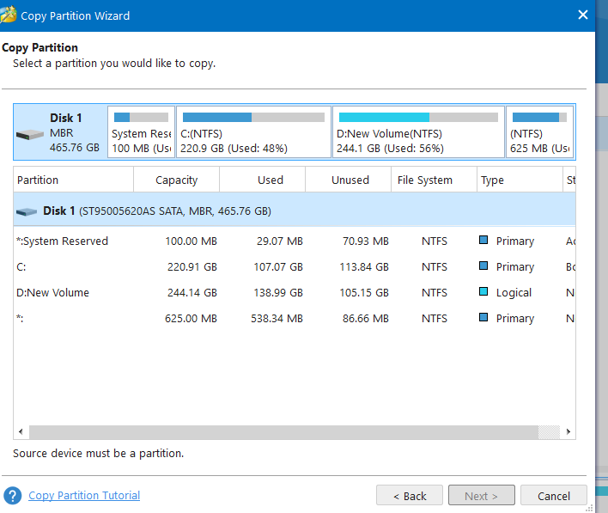
Then I opened it all the drives of my Pc was displaying there, then the boot drive system was disk 1, the target drive and is on disk 2, now I wanted to clone disk 1 to disk 5. then I position the curse on disk 1 then I clicked right button then I choose copy, then I went to disk 2 I selected it , then I clicked next. then I choose fit partition, then I clicked next again then finish. Then the process of migration start, it was taking a bit time to finish, then after time the process has finished. Then after that I went to boot into BIOS settings and set up the boot drive to disk 2.

Slide 6
Thank you

